Slide 1
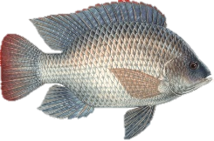
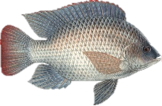
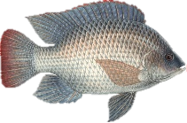


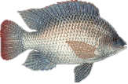
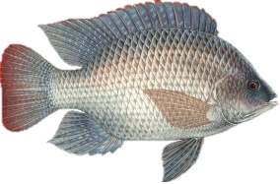

Single Aquaculture Production Unit (APU) Start up Information
Input Costs(Rands)
Year 1 Year 2 +
Stock Fingerlings 9000 9000
Feed 11405 21507
Electricity 3153 3468
Water Testing 800 850
Labour Own and Part Time
Water If Municipal 50 Liters/day
Production
Outputs(Fish)
Year 1 Year 2 +
Fish # 1500 3000
Fish Kgs 626 1074
Capital Investment (Rands) Option 1 Option2
APU 35 500 35500
Heat Pump 15000
Hobby Greenhouse 40 000
TOTAL 75 500 50500
Returns (Rands)
Year 1 Year 2 +
Sales 31,334 59,087
Knowledge and Skills Development
Farm Tour and discussion
R500
Training and Practical “Wet Hands” R6 000
4 days with Material and Lunches
Gross Profits (Rands)
Year 1 Year 2 +
Gross Profit 6,975 24,230

